Slide 1

Improving Student Performance through Parent Involvement at Different School Levels and Locations
Gators: Zachary Allen, Luke Androski, Anthony Hernandez, and Finian Hanley
Advisor: Professor Elizabeth Johnson
University of Florida

Slide 2
Are Students Unhappy?
The percentage of parents that report their child does not enjoy school increases by school level
6.40%
of students in Elementary School
11.86%
of students in Middle School
15.99%
of students in in High School
Likewise, the percentage of students that have grades which consist of mostly C’s or D’s also increases by school level
7.31%
of students in Elementary School
11.51%
of students in Middle School
14.16%
of students in High School

Slide 3
Research Question
Which types of Parental Involvement have the most positive on student grades at each school level and how are they distributed geographically?
General Idea:
Define “Types of Parent Involvement”
Find which types of Parent Involvement have the most positive impact on grades at each school level (Elementary, Middle, High)
Of those types, which zip code types (Rural, Town, Suburb, City) and regions (Northeast, South, Midwest, West) are performing well/poor in that category

Slide 4
Background: Types of Parent Involvement
We will examine six types of parent involvement in education as defined by Dr. Joyce Epstein and their individual/combined effects on student satisfaction at each school level:
Parenting (P): How home environments are established to support children as students.
Communicating (C): School-to-home and Home-to-school communications about school programs and child progress.
Volunteering (V): The recruiting and organization of parent help and support.
Learning at Home (LH): How parents help students at home with homework and other curriculum related activities, decisions, and planning.
Decision-making (DM): How are families included as participants in school decisions and how parent leaders/representatives created.
Collaborating with Community (CC): How resources and services from the community for families, students, and schools are coordinated.

Slide 5
Background: P.I by Income & Region
Many studies show a relation between Parental Involvement and academic achievement in specific economic classes and geographical areas.
Why Rural Matters: Shows rural students face challenges with high rates of poverty, diversity and students with special needs. All of which could have a substantial effect of grades.
Parent Involvement: The Key To Improved Student Achievement: Shows parental involvement improves 3rd graders academic performance over a 2-year period in inner city Chicago.
Parent Involvement in Adolescents' Education: A Case Study of Partnership Models: Asserts education and parental involvement cannot be separated.
Outside of studies, there are many ways Parental Involvement can across Rural/Urban areas and parental incomes. For example
Rural families have less access to museums, libraries, etc.
Higher income families may have more time to spend with children and more money to spend on tutors. Lower income parents might focus on a different type of involvement because of this.

Slide 6
Methods & Findings
Data Cleaning and Analysis
Anthony’s Methods:
Correlation Matrices
Factorial ANOVA and Linear Regression
Factor Level Means
Zack’s Methods:
Cumulative Logit Model of Proportional Odds
Multiple Logistic Regression
Combined Results

Slide 7
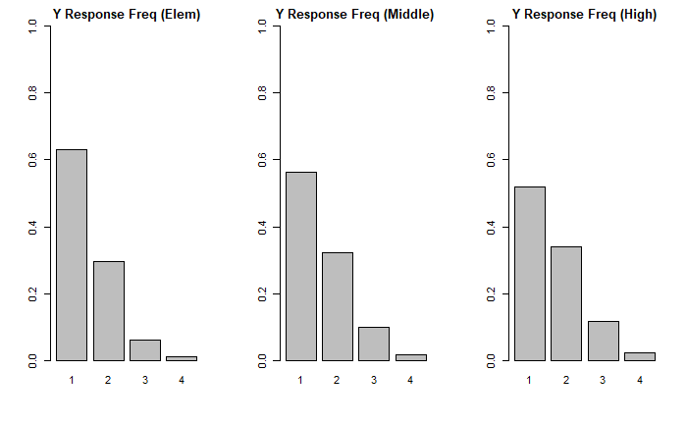
Data Cleaning and Analysis
We are trying to predict “SEGRADES”, a categorical variable with the following encodings for a given students’ grades:
1 = Mostly A’s
2 = Mostly B’s
3 = Mostly C’s
4 = Mostly D’s or lower
5 = School does not use this grading system

Slide 8
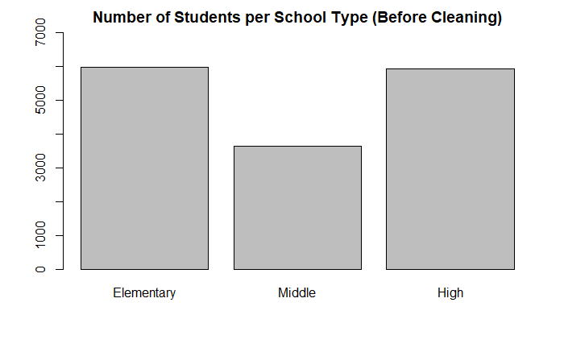
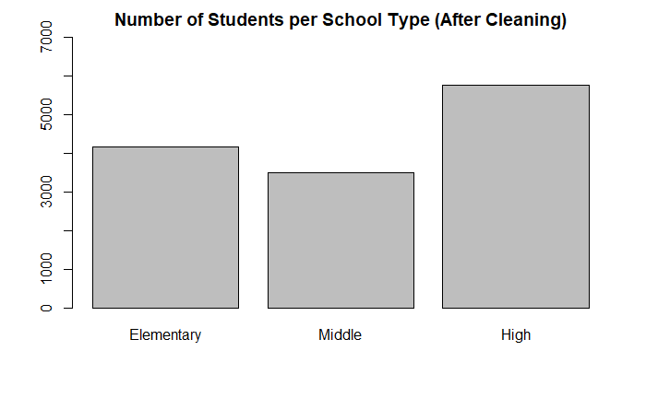
Data Cleaning and Analysis (contd.)
Removed any rows with -1 as an observation (invalid data)
Encoded each observation based on school level
1 = Elementary, 2 = Middle, 3 = High
Removed any rows where the school does not use A,B,C,D letter grades
This removed ~ 2000 observations from Elementary Level

Slide 9
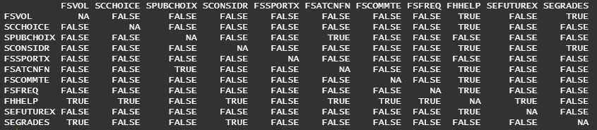
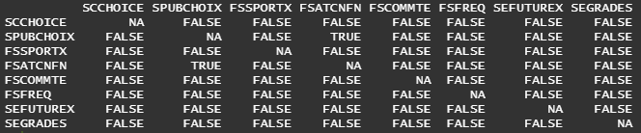
Anthony’s Methods
I tested for multicollinearity to find whether certain variables were unnecessary for the model using a 95% level of confidence.
Ho: There is no relationship between the predictors for Parent Involvement
Ha: At least one or more of the variables are correlated
Rejected the null hypothesis. FSVOL and FHHELP were removed as they found to be highly correlated with the other predictors.
When testing the new correlation matrix:
Reject the null hypothesis. There is significant evidence to conclude that at least one or more of the variables are correlated with p-values above the 0.05 significance level, showing as TRUE in the output. (FSATCNFN and SPUBCHOIX)

Slide 10
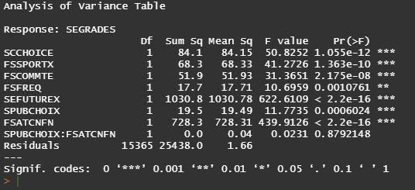
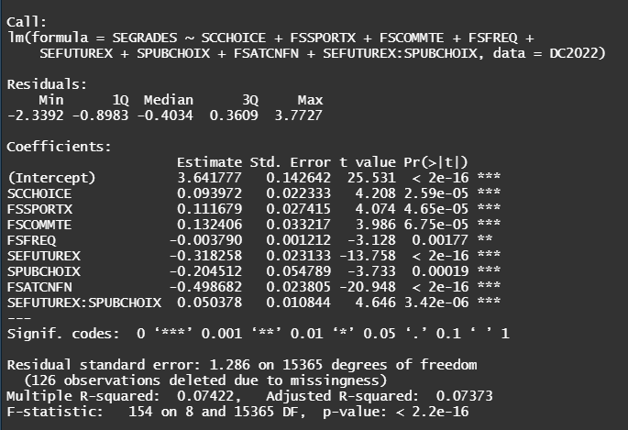
Anthony’s Methods (contd.)
Due to the last result and finding the majority of the model above to have low correlation, I used ANOVA to test to see if there was any significant interaction between FSATCNFN and SPUBCHOIX.
Ho: There is no interaction between the FSATCNFN and SPUBCHOIX
Ha: There is an interaction between the FSATCNFN and SPUBCHOIX Conclusion: Do not reject the null hypothesis.
Next, I tested the full interaction model to see if any interaction between the predictors may be significant and after sifting through, I found the model with the highest adjusted R-squared in which SEFUTURE had a significant interaction with SPUBCHOIX.
Ho: There is no interaction between the SEFUTUREX and SPUBCHOIX
Ha: There is an interaction between the SEFUTUREX and SPUBCHOIX Conclusion: Reject the null hypothesis.
This interaction makes sense because if a parent has expectations for their child's success, they are likely to proactively choose the school their child will attend.

Slide 11
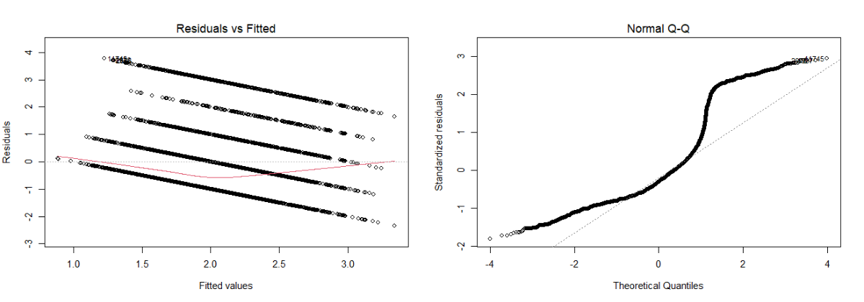
Anthony’s Methods (contd.)
We also conducted an F-test to determine the overall significance of the model.
Ho: All of the predictors’ means are equal
Ha: The means are not all equal
Conclusion: Reject the null hypothesis
Upon further analysis of this model, we see that the Adjusted R-squared is still only 0.07373 so this model may not be the best fit for our data.
Because of the U-shape in the Residuals vs Fitted plot, this might not be the best fit for our data and some type of transformation might fit the data better. The Normal QQ plot shows that near 2 standard deviations above the mean, the data is highly above the normal values, showing that this model does not appear to be normal.

Slide 12
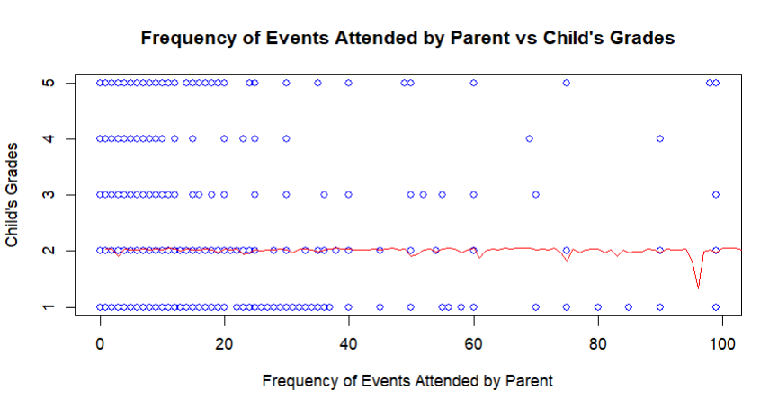
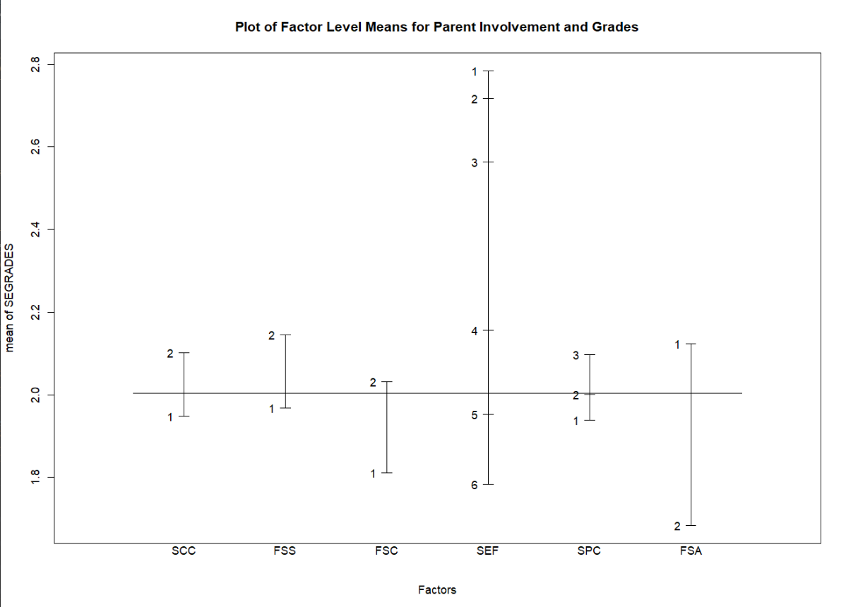
Anthony’s Methods (contd.)
Aside from the faulty model, I do believe that there is useful data showing that parent involvement has a significant effect on the mean of grades.
The Factor level means plot shows that as parents are more involved and have higher expectations for their children, the mean level of grades is higher. The only difference is in parent-teacher conferences, but those generally involve a student getting into trouble and receiving disciplinary action, so not attending those conferences could be perceived as a positive reflection of the student’s behavior.
The plot of the frequency of events attended by Parent vs their Child’s grades does not show that it has much of an effect on grades at all, meaning that the quantity of events attended more than likely has no interpretable significance on a student’s grades.
Conclusion: It seems that further analysis on this data may be necessary to find a model that can portray the effects of these graphed differences. It is possible that we either need to find external data to help support our theses or further group our data in a way that shows significance.

Slide 13
Zack’s Methods: Variable Selection
16 binary variables (yes/no survey questions) were used and grouped based on which type of Parent Involvement the question covers. The sum of Yes responses for each group were used as predictors.
Variable Name | Parent Involvement Type | Question
SEFUTUREX | Parenting (P) | Do you expect your child to earn a Bachelor’s Degree or higher?
SCCHOICE | Parenting (P) | Did you feel that you had a choice in what school this child attends?
FSATCNFN | Communicating (C) | This school year, has any adult in this child’s household gone to a regularly scheduled parent-teacher conference with this child's teacher?
FSCOUNSLR | Communicating (C) | This school year, has any adult in this child’s household met with a guidance counselor in person?
FSMTNG | Communicating (C) | This school year, has any adult in this child’s household attended a general school meeting?
FSVOL | Volunteering (V) | This school year, has any adult in this child’s household served as a volunteer in this child’s classroom or elsewhere in the school?
FSFUNDRS | Volunteering (V) | This school year, has any adult in this child’s household participated in fundraising for the school?
FSPTMTNG | Decision Making (DM) | This school year, has any adult in this child’s household attended a meeting of the parent-teacher organization or association?
FSCOMMTE | Decision Making (DM) | This school year, has any adult in this child’s household served on a school committee?
FSSPORTX | Collab w Community (CC) | This school year, has any adult in this child’s household attended a school or class event?
FOCRAFTS | Collab w Community (CC) | In the past week, has anyone in your family done activities like arts and crafts?
FOGAMES | Collab w Community (CC) | In the past week, has anyone in your family played board games or did puzzles with him or her?
FOBUILDX | Collab w Community (CC) | In the past week, has anyone in your family worked on a project like building/fixing something?
FOSPORT | Collab w Community (CC) | In the past week, has anyone in your family played sports, active games, or exercised together?
FOLIBRAYX | Collab w Community (CC) | In the past month, has anyone in your family visited a library with this child?
FOBOOKSTX | Collab w Community (CC) | In the past month, has anyone in your family visited a bookstore with this child?
parenSum
commSum
volSum
dmSum
collabSum

Slide 14
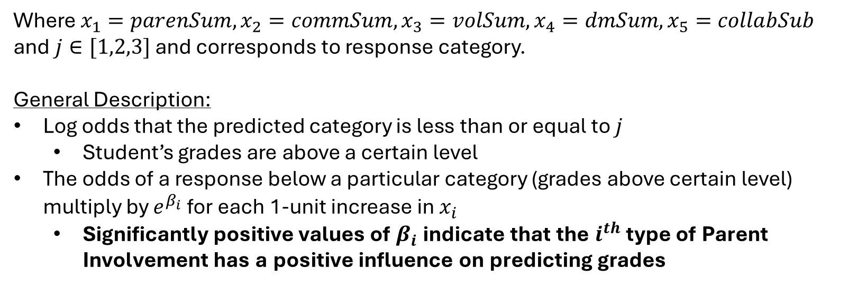
Zack’s Methods: Cumulative Logit Model
Cumulative Logit Model with Proportional Odds Definition:
$log\left(\frac{P(Y≤j)}{1−P(Y≤j)}\right)=α_{j}+β_{1}x_{1}+β_{2}x_{2}+β_{3}x_{3}+$ $β_{4}x_{4}$ $+$ $β_{5}x_{5}$
Where $x_{1}=parenSum,x_{2}=commSum,x_{3}=volSum,x_{4}=dmSum,x_{5}=collabSub$
and $j∈[1,2,3]$ and corresponds to response category.
General Description:
Log odds that the predicted category is less than or equal to $j$
Student’s grades are above a certain level
The odds of a response below a particular category (grades above certain level) multiply by $e^{β_{i}}$ for each 1-unit increase in $x_{i}$
Significantly positive values of $β_{i}$ indicate that the $i^{th}$ type of Parent Involvement has a positive influence on predicting grades

Slide 15
Zack’s Methods: CLM Results
Elementary Model
Variable | Estimate | exp(Estimate) | P-value
parenSum | 0.31205 | 1.366225 | 1.50e-09
commSum | 0.37387 | 1.453344 | 1.16e-13
volSum | -0.47882 | 0.619512 | < 2e-16
dmSum | 0.06721 | 1.069524 | 0.207
collabSum | -0.16106 | 0.851243 | 1.42e-13
Middle Model
Variable | Estimate | exp(Estimate) | P-value
parenSum | 0.56025 | 1.7511165 | < 2e-16
commSum | 0.42594 | 1.5310248 | < 2e-16
volSum | -0.48858 | 0.6134993 | < 2e-16
dmSum | -0.07200 | 0.9305285 | 0.226
collabSum | -0.10859 | 0.8971025 | 5.68e-07
High Model
Variable | Estimate | exp(Estimate) | P-value
parenSum | 0.657659 | 1.9302688 | < 2e-16
commSum | 0.227761 | 1.2557854 | 3.24e-15
volSum | -0.465061 | 0.6280969 | < 2e-16
dmSum | -0.003942 | 0.9960661 | 0.932
collabSum | -0.132991 | 0.8754730 | 8.81e-15

Slide 16
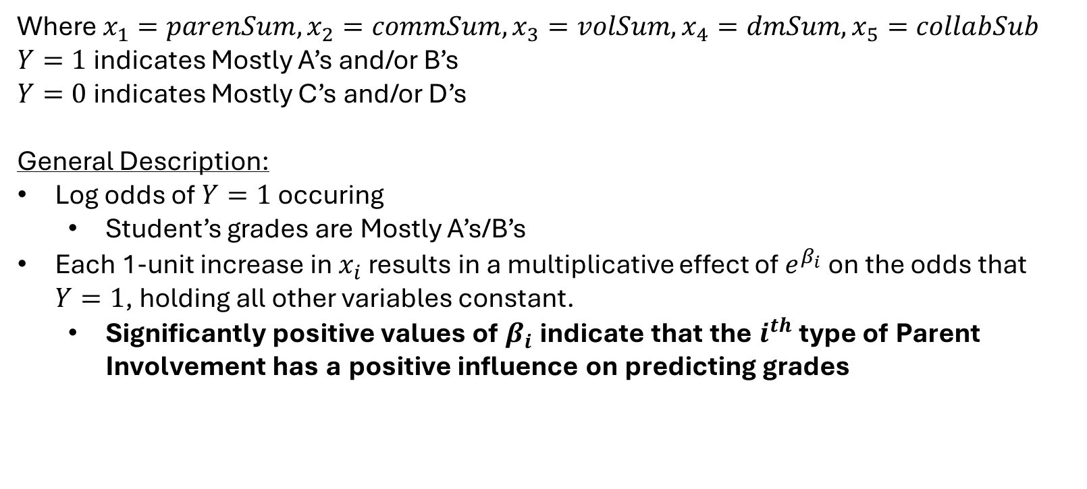
Zack’s Methods: Multiple Logistic Regression
Multiple Logistic Regression Definition:
$log\left(\frac{P(Y=1)}{1−P(Y=1)}\right)=α+β_{1}x_{1}+β_{2}x_{2}+β_{3}x_{3}+$ $β_{4}x_{4}+ β_{5}x_{5}$
Where $x_{1}=parenSum,x_{2}=commSum,x_{3}=volSum,x_{4}=dmSum,x_{5}=collabSub$
$Y=1$ indicates Mostly A’s and/or B’s
$Y=0$ indicates Mostly C’s and/or D’s
General Description:
Log odds of $Y=1$ occuring
Student’s grades are Mostly A’s/B’s
Each 1-unit increase in $x_{i}$ results in a multiplicative effect of $e^{β_{i}}$ on the odds that $Y=1$, holding all other variables constant.
Significantly positive values of $β_{i}$ indicate that the $i^{th}$ type of Parent Involvement has a positive influence on predicting grades

Slide 17
Zack’s Methods: MLR Results
Elementary Model
Variable | Estimate | exp(Estimate) | P-value
parenSum | 0.38066 | 1.46325 | 5.29e-05
commSum | 0.59820 | 1.81884 | 4.25e-10
volSum | -0.60929 | 0.54374 | 1.46e-12
dmSum | 0.07853 | 1.0817 | 0.451
collabSum | -0.21754 | 0.8045 | 4.04e-08
Middle Model
Variable | Estimate | exp(Estimate) | P-value
parenSum | 0.77923 | 2.17979 | < 2e-16
commSum | 0.52047 | 1.68282 | 5.25e-13
volSum | -0.68904 | 0.50206 | < 2e-16
dmSum | -0.03212 | 0.96839 | 0.751
collabSum | -0.18398 | 0.83195 | 2.24e-07
High Model
Variable | Estimate | exp(Estimate) | P-value
parenSum | 0.78987 | 2.20311 | < 2e-16
commSum | 0.30534 | 1.35709 | 1.71e-12
volSum | -0.56875 | 0.56623 | < 2e-16
dmSum | -0.06950 | 0.93286 | 0.349
collabSum | -0.14603 | 0.86413 | 3.66e-08

Slide 18
Combined Conclusions
The Parenting and Communication types of Parent Involvement seem to have the most positive impact on predicting student grades
Important: Just because the other types appear to negatively impact grades does not mean they should be ignored in practice based on these models. Doing so would contradict many years of research and there are many confounding variables that can influence overall student success (outside of grades) in which those parent involvement types are still very important.
Specific Variables of Interest:
FSATCNFN (C): Has any adult gone to a regularly schedule parent-teacher conference
FSCOUNSLR (C): Has any adult met with a guidance counselor in person
FSMTNG (C): Has any adult attended a general school meeting (open house, etc.)
SEFUTUREX (P): How far do you expect the child to go in their education
SCCHOICE (P): Did the parent have a choice in what school the child attends
Next Up: How the grouping of these variables are distributed geographically

Slide 19
Geographical Distributions of Key Variables
Finn repeated Zack's CLM methods for the elementary, middle and high school models with the geographical regions Northeast, South, Midwest and West. The exponentiated coefficients we're as follows:
Northeast
South

Slide 20
Geographical Distributions of Key Variables
Midwest
West
These results are mostly unsurprising; Northeast, South and West are all close to each other and close to our previous results from the elementary, middle and high school models.
Midwest has a much higher parenSum exponentiated coefficient, meaning that in this region parental involvement seem to have a much higher effect on students' grades.

Slide 21
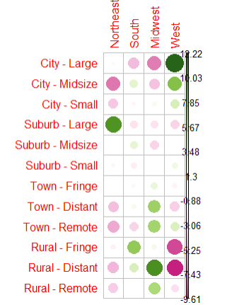
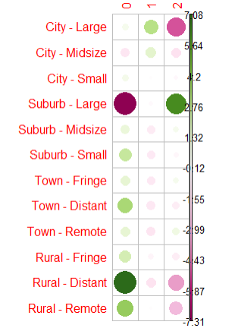
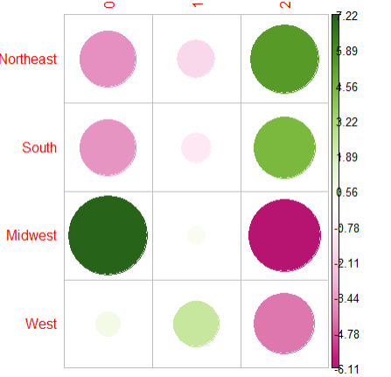
Geographical Distributions of Key Variables
Chi-Squared Residuals
Geo. Region vs.
parenSum
We explored reasons for the Midwest's parenSum exponentiated coefficient being so much higher than the other regions. We found that the Midwest is much more rural, possibly meaning that children have less access to resources in towns and school, meaning parents would have to pick up the slack.
Chi-Squared Residuals Zip Code Classification vs. Geo. Region
Chi-Squared Residuals Zip Code Classification vs. parenSum
Green = more than we would expect under independence
Pink = less than we would expect under independence

Slide 22
Recommendations
Ensure parents are maintaining a positive outlook towards the child’s education and establishing home environments that allow the child to succeed (P) through consistent communication between the parent and the school (C)
Extra resources should be allocated by school districts to Rural locations since they appear to be doing poor in the previously mentioned categories.
Specifically in the Midwest, where the region is primarily Rural and (P) has a significantly greater effect compared to other regions, but is severely lacking

Slide 23
References
Joyce Epstein, Six Types of Parent Involvement
Why Rural Matters
Parent Involvement: The Key To Improved Student Achievement
Parent Involvement in Adolescents' Education: A Case Study of Partnership Models

